Slide 2

Unit 1: Getting Started with Oracle APEX

Slide 3
Lesson Objectives
After completing this lesson, you should be able to:
Describe Oracle APEX
Explain the key features of Oracle APEX
Describe low code application development
List and describe the components of Oracle APEX
Describe Oracle APEX architecture
Log in to Oracle APEX
Install and run a packaged app
Notes:
In this lesson, you are introduced to Oracle Application Express. You learn how to log in to Oracle APEX, and navigate through different components. You also learn how to install and run a packaged app.

Slide 4


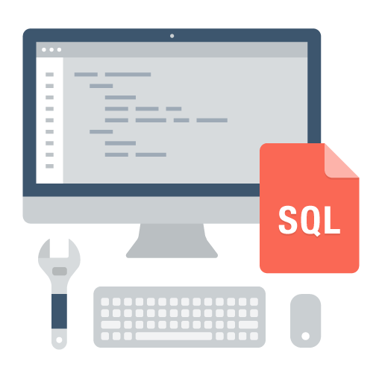
What is Oracle APEX?
Database-centric web application development framework
Develop desktop and mobile web apps
Visualize and maintain
database data
Leverage SQL Skills and database capabilities
Notes:
Oracle Application Express (Oracle APEX) is a rapid Web application development tool for the Oracle Database.
Oracle Application Express enables you to design, develop and deploy beautiful, responsive, database-driven applications using only your web browser. You use Oracle APEX to build desktop and mobile applications for the Oracle Database.
Using Oracle Application Express you can quickly build reports, forms, charts, calendars, etc. on top of the data in your database.
Oracle Application Express enables organizations to capitalize on their existing investment in SQL and PL/SQL skills. Few programming skills are required, and anyone can quickly learn to develop applications. With Oracle Application Express, applications are built faster, with fewer developers.

Slide 5
Oracle APEX
What sorts of apps is Oracle APEX suitable for?
Large mission-critical apps for thousands of users
Fill in gaps in corporate systems
Streamline outdated business processes
Modernization of legacy systems
Self-service apps for all employees
Customer / partner-facing portals
Responsive apps that work on any device
Proof of Concepts
Quick-win apps (lifespan < a few months)
Replacing spreadsheets
Notes:
Application Express is used by large and small customers alike, across a broad number of industries, and is used to solve a vast array of business problems - from simple spreadsheet replacement to multi-thousand user banking and insurance applications. APEX may not be suitable for building the next Facebook app, but it is extremely well suited to meet the requirements of the majority of business requirements.

Slide 6
Oracle APEX: Use Cases
Spreadsheet Replacement
Features
Drag and Drop an XLS, CSV, XML, or JSON file
Create table in Autonomous Database
Upload data into new table
Create App based on new table
Solutions
Single source-of-truth
Send out a URL not a file
Secure, scalable, multi-user app
Extend with Charts, Calendars, Validations, and more
Copyright © 2019, Oracle and/or its affiliates. All rights reserved.
6
Notes:
Use Oracle APEX to replace spreadsheets used for business critical functions.
Almost every organization utilizes spreadsheets to disseminate and report on data. Because spreadsheets are so easy to create - anyone can put together a spreadsheet once they have the data. Once created they often send it out to colleagues to help update, and so forth. This inevitably leads to numerous copies with different data and very flawed business processes. A far better solution is to have a single source of truth stored in a fully secured database with a browser-based app that everyone can use to maintain the data.
From a Spreadsheet to Web app in Minutes: Use the wizard and just a few clicks to transform your spreadsheet into a fully-populated table in Oracle Database, complete with a fully functioning app with a report and form for maintaining the data.
Single Source of Truth: Instead of having any number of spreadsheets floating around, users log into APEX to access a single centralized app where everyone maintains the data, and everyone always sees the same data.
Advanced Security: Spreadsheets generally lack authentication and auditing capabilities. APEX apps can utilize SSO, LDAP, or Social Login and can readily incorporate audit tracking. The Oracle Database, where the data resides, is generally professionally backed up by DBAs.
Fully Relational: Implementing master-detail type relationships in spreadsheets is exceedingly hard, so most spreadsheets are flat making it hard to properly analyze the data. APEX runs on top of the fully-relational Oracle Database where implementing referential integrity is trivial. Furthermore, APEX allows you to declaratively define master-detail pages with ease.

Slide 7

Oracle APEX: Use Cases
Extending Enterprise Systems
Features
Extend ERPs and other enterprise software
Provide organization-specific dashboards
Improved workflows
Fill gaps
Solutions
Meet non-standard requirements
Optimize common business functions
Enhance data capture
Integrate disparate data sources
See: Extend E-Business Suite using APEX - Official white paper
Notes:
Oracle APEX is used for extending COTS Software to streamline for your business processes or meet organization specific requirements
ERP systems provide extensive functionality out-of-the-box, however, they don't always provide the specific reports you need, or may be missing functionality, especially if it is specific to your industry or your organization. You may also find common business processes that take far too many steps to complete making them inefficient. In such cases, building an extension using APEX can deliver the appropriate information or greatly improve productivity and hence user satisfaction.
Interactive Reporting: Allow end users to readily manipulate the data so they can meet their reporting needs. This includes column selection and ordering, filtering, sorting, computations, aggregates, and even the ability to pivot data. End users can even their reports for just themselves or for everyone to see.
Streamline Processes: Develop an extension which delivers a simplified business process consisting of fewer steps. Importantly the extension retrieves the necessary data from the ERP system and then sends the completed work products back into the ERP system.
Bespoke Development: Meet company or industry specific requirements by building bespoke applications. Such apps should utilize the appropriate ERP data, but may well have local database objects to store additional data not available in the ERP system.
Tight Integration: APEX can be used to include data from disparate systems, not just data from your ERP, to build better dashboards and reports, or more complex business flows. Such data can be obtained utilizing REST Web Services, or from linking to another database to extract and/or post data.

Slide 8
Oracle APEX: Use Cases
Modernizing Oracle Forms
Features
APEX is the natural evolution of Forms
Both based on SQL and PL / SQL
Re-use DB packages, procedures, functions
Easily train Forms Developers into developing with APEX
Solutions
Proof-of-concept using subset of Forms apps
Organization-wide apps, rather than back-office
External apps for customers / partners
Mobile-first apps
Net new requirements
Notes:
You can convert legacy Oracle Forms apps that are no longer meeting requirements to APEX.
Oracle Forms applications often provide an out-of-date client/server user experience, may have poor usability and accessibility issues, have difficulties working with various browsers, and are not mobile friendly. Finally, it is often difficult and cost prohibitive to hire skilled Oracle Forms developers.
For net new requirements or major functional upgrades, it may be best to consider your alternatives. As Oracle APEX and Oracle Forms are both SQL and PL/SQL based, and provide declarative development environments, it is easy for developers to transition from Oracle Forms to Oracle APEX.
Modern, Beautiful, Responsive, Web-based Apps: The Universal Theme within APEX produces modern apps with the ability to declaratively define different theme styles and easily utilize template options to develop apps your end users will love to use.
Cohesive Design Patterns: APEX makes it easy to develop intuitive, accessible apps similar to other popular Web apps. End Users should be able to navigate around and use all the functionality within an APEX app without needing training, which also makes it ideal for customer or partner facing apps.
Rapid Application Development: Given APEX is metadata-based then it is very quick and easy to maintain or enhance the page definitions as needed. If you need to fully extend a page you can utilize SQL, PL/SQL, JavaScript, HTML, and CSS.
Run on *any* Web Browser: Running an APEX app is 100% browser based, and requires no client software. The apps are fully-responsive, making them mobile-ready by default, which means they can run in your browser on any device.

Slide 9

Oracle APEX: Use Cases
Rapid Application Development
Features
Build apps in days / weeks not months / years
Use powerful wizards to create fully featured apps
Easily modify to meet changing requirements
Rapidly iterate to production-ready app
Low-code capabilities allow non-IT professionals to also build or help build apps
Solutions
Opportunistic
Simplistic, tactical apps to meet immediate need
Webify paper processes
Generally developed by one or two people
9
9
Notes:
Oracle APEX is widely used to rapidly build applications that are needed ASAP to meet changing business requirements and maximize competitive advantage.
Organizations have a huge backlog of apps they require to meet every changing business needs and to stay competitive. These are generally not enterprise apps and may only be required for a limited time, but are needed yesterday. The requirements may be poorly defined, and the business priorities may change rapidly, which is why the apps must be very fast to build and easy to update as required.
Concept to Working Prototype in Minutes: You can define new data structures, complete with sample data, using Quick SQL. Quick SQL allows you to generate SQL scripts based on a simple shorthand syntax. These scripts can be saved and easily run within your Oracle APEX environment to create database tables, triggers and views. Then use the Create App Wizard to create reports and forms for the tables you defined. You can even add additional functionality, such as access control, activity reporting and more, to create a fully featured app in minutes.
Apply Low-Code Development Practices: IT professionals and tech-savvy business users can both use the low code capabilities within Oracle APEX to quickly build apps. Oracle APEX is easy to use and easy to learn. The Application Builder provides a rich, browser-based, intuitive interface which guides you through the creation of your applications. The powerful components of Oracle APEX enable you to add a high-level of functionality to your apps with limited coding.
Agile Development: Development with Oracle APEX is all about rapidly iterating the application and reviewing with the end users. Developers can easily work with end users and implement changes and enhancement requests, often in real time. APEX is just as fast at maintaining and enhancing existing apps as it is to build the first prototype.

Slide 10
Oracle APEX: Use Cases
Build Large, Enterprise-scale Apps
Features
Quickly build custom mission-critical apps
Corporate data reporting and maintenance
Merge separate data silos
Build organization-wide self-reporting apps
Solutions
Simple deployment
Single installation runs any number of apps
Scale to hundreds of thousands of users
Leverages enterprise features of Oracle Autonomous
Notes:
Oracle APEX is used to quickly build mission critical enterprise applications used by thousands of users on a daily basis.

Slide 11
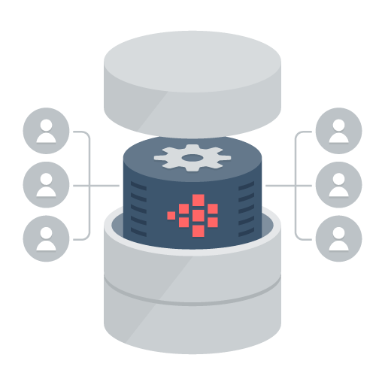
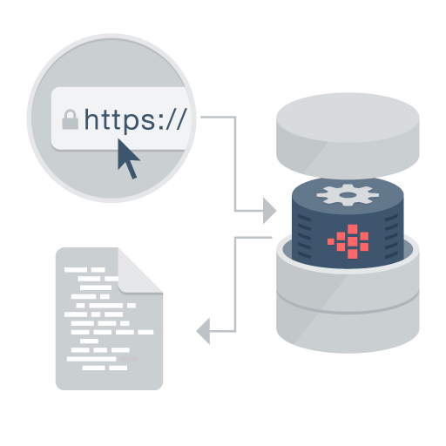
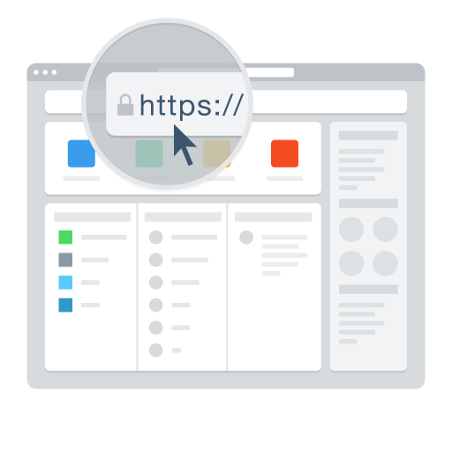
Oracle APEX: Distinguishing Characteristics
Page generation is efficient with only one request and one response.
Data processing done in the Database
App Development IDE is a web browser. No client software needed
App definitions are stored in the database as meta data.
Declarative – No code generation
Notes:
With Oracle Application Express, you simply use a web browser and the URL to access the development environment, or the URL and user credentials to run the application. You do not need any client software.
If you have the Oracle Database, you already have Application Express. Since 2004, Application Express has been a fully supported and no-cost feature of the Oracle Database. Your application developed in Oracle Application Express does not require complex build scripts to run in production. More importantly, your application automatically scales with your Oracle Database. You can seamlessly move applications to and from the Oracle Database Cloud Service, private (on premise) clouds and other public cloud services. Oracle Application Express installs with your Oracle Database and is comprised of data in tables and PL/SQL code. Whether you run the Oracle Application Express development environment or an application you built using Oracle Application Express, the process is the same. Your browser sends a URL request that is translated into the appropriate Oracle Application Express PL/SQL call. After the database processes the PL/SQL, the results are relayed back to your browser as HTML. This cycle happens each time you request or submit a page. The application session state is managed in the database tables within Oracle Application Express. It does not use a dedicated database connection. Instead, each request is made through a separate database session, consuming minimal CPU resources.

Slide 12
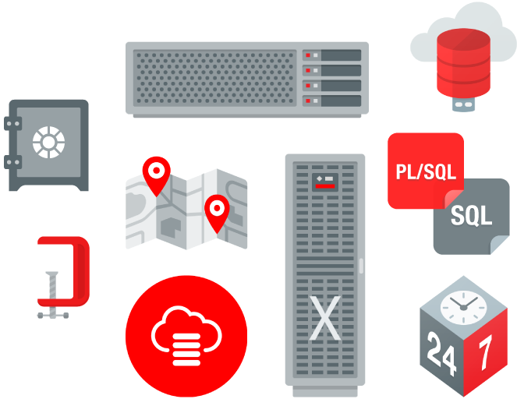
Oracle APEX: No Cost Feature of the Oracle Database
No-cost fully supported feature
Any number of apps, developers & end-users
Specialized Oracle Support Team
11gR2, 12c, 18c, 19c
All DB editions: EE, SE, SE1, XE
Included with Oracle Cloud Services
No cost evaluation https://apex.oracle.com
Easy to install
Included by default with all editions of Oracle database
Download latest release from https://apex.oracle.com/otn
Notes:
Oracle Application Express is a feature of the Oracle Database with no licensing costs for development or deployment of Application Express applications.
The Oracle Database Maintenance Agreement also covers support for Application Express.
You can build applications with Oracle APEX on Oracle Autonomous Database. See the next slide for more information about Oracle APEX on Autonomous Database.
Application Express is released more frequently than the Oracle DB so important to get the latest version of Oracle Application Express from OTN.

Slide 13
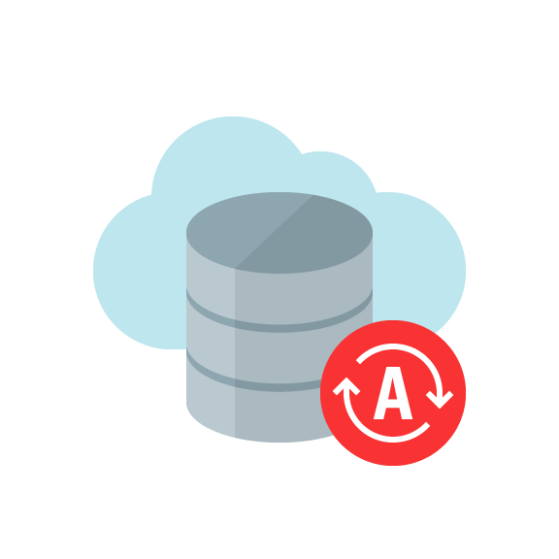

Oracle APEX on Oracle Autonomous Database
Oracle Autonomous Database
Oracle APEX
Notes:
Oracle Autonomous Database brings together decades of database automation, decades of automating database infrastructure, and new technology in the cloud to deliver a fully autonomous database that is available in two flavours:
Autonomous Transaction Processing: Provides market-leading performance with a fully tuned database optimized for transaction processing or mixed workloads.
Autonomous Datawarehouse: Provides an easy-to-use, fully autonomous database that scales elastically, delivers fast query performance and requires no database administration.
Oracle APEX on Autonomous Database provides a preconfigured, fully managed and secured environment to both build and deploy world-class data-centric applications. There are no limits on the number of developers or end users for your Oracle APEX applications; Autonomous Database can instantly scale compute and storage online as needed, based upon your workload. Additionally, Oracle APEX applications developed on-premises can be easily deployed to Oracle APEX on Autonomous Database, or vice-versa.
Configuration, patching, monitoring, and upgrading of all Oracle Application Express components is fully managed by Oracle, leaving you free to focus on developing your solutions and solving your business problems. With Oracle APEX and low code, your organization can be more agile and develop solutions faster, for less cost, and with greater consistency. You can adapt to changing requirements with ease. And you can empower professional developers and everyone else in your organization to be a part of the solution.
To learn more about Oracle APEX on Autonomous Database, see https://apex.oracle.com/autonomous.

Slide 14




Oracle APEX: Rapidly Develop, Customize, and Deliver
Pre-built controls for security, authentication, database interaction, validation, session management and more…
Go from prototype to production in minutes
Develop
Customize
Deliver
Notes:
At the core of Application Express is an engine that provides a variety of fundamental application capabilities and operations. Application authentication, page/object-level access control, database interaction (queries/updates etc), form validation, session management and protection, and more is available as standard components that can be utilised from every application without custom development.
Application objects such as forms, reports, charts, navigation etc are defined declaratively, enabling applications to be functionally complete in a short period of time, increasing agility in application development.

Slide 15
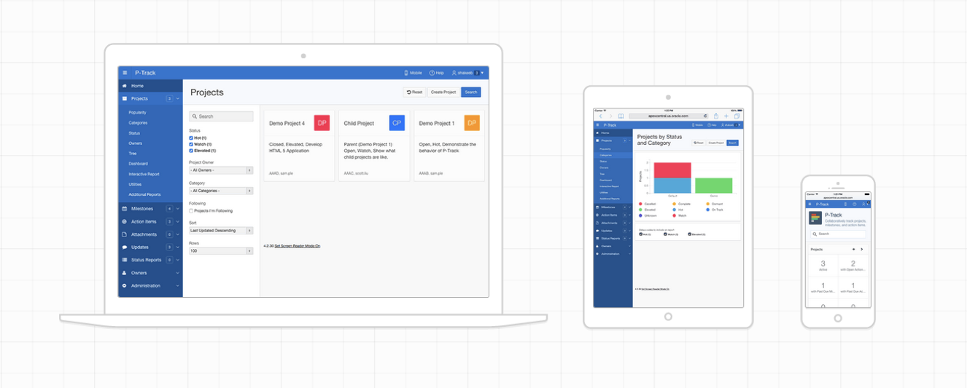
Oracle APEX: User Interface for Any Device
Modern, intuitive, accessible UI for any device
fully customizable and responsive apps

Slide 16
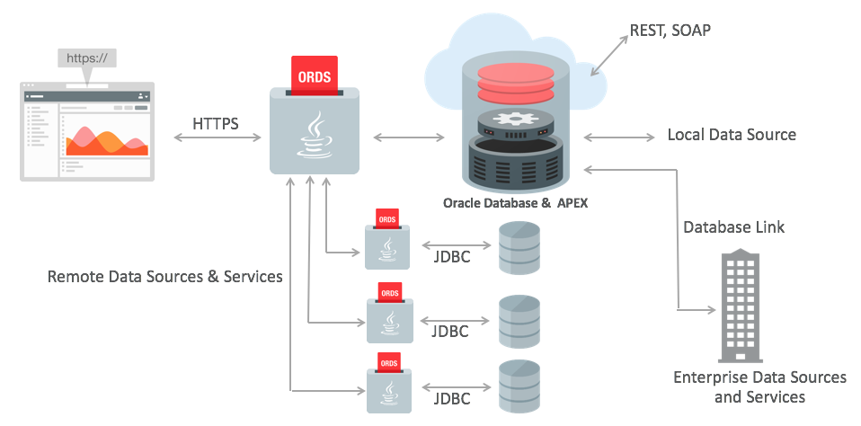
Data Sources: Local, Remote, and REST Access
Notes:
Oracle APEX is best suited to being co-located with the data it is maintaining / reporting on.
Oracle APEX provides the ability to execute SQL not only in the "local" Oracle database (where APEX runs in), but also on a remote Oracle instance. This is based on the REST Enabled SQL feature introduced with ORDS 17.4. When the REST Enabled SQL feature is active on an ORDS instance, SQL statements can be passed in JSON format using HTTP POST requests. Execution results are being passed back as a self-describing JSON response. Clients thus can communicate with the Oracle database using open protocols and without SQL*Net. A prerequisite for using REST Enabled SQL is to have at least ORDS 17.4 installed. Older ORDS versions (3.0.x) do not support REST Enabled SQL.
Oracle APEX provides declarative support for REST Services in Application Express components - that means, developers will be able to create a component, for example, an interactive report, directly on an external REST service. You can register an external REST Service as a Web Source Module in Shared Components and then use it as the data source for an interactive report or a classic report.
You can also integrate into a SOA environment by consuming Web Services (both REST and SOAP) or utilize DB Links to other databases.
You learn about reports and forms in Oracle APEX later in this course.

Slide 17

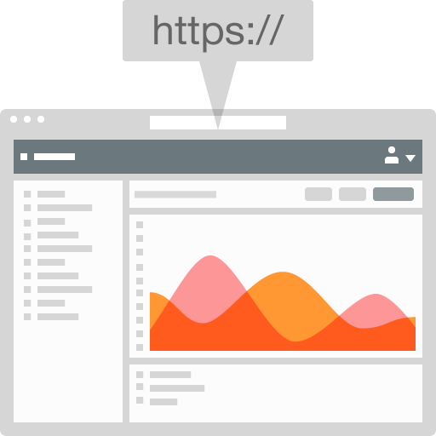

Oracle APEX Architecture
REST, SOAP
Schemas
HTTPS
JDBC
APEX Engine
SQL & PL/SQL
Oracle REST Data Services
(Weblogic, Jetty, Tomcat)
Oracle Database
(Pluggable or Dedicated, 11g, 12c, 18c)
No Application Logic
Converts HTTP to database API calls
Zero latency database data access
Dynamically driven by APEX metadata
Browser
Mid Tier
Database Tier
Notes:
The Oracle Application Express architecture requires some form of Web server to proxy requests between a client Web browser and the Oracle Application Express engine. The Web server options include:
Oracle REST Data Services: Oracle REST Data Services (ORDS) is a Java based, free tool that is fully supported when used with Oracle WebLogic Server, Oracle Glassfish Server, and Tomcat.
Embedded PL/SQL Gateway: The Embedded PL/SQL Gateway (EPG) runs in the Oracle XML DB Protocol Server within the Oracle Database and includes the core features of mod_plsql.
Oracle HTTP Server: The Oracle HTTP Server (Apache) with mod_plsql plugin can be placed on the same physical machine as the database, or on a separate physical machine. Please note that mod_plsql is deprecated as of Oracle HTTP Server 12c (12.1.3).

Slide 18
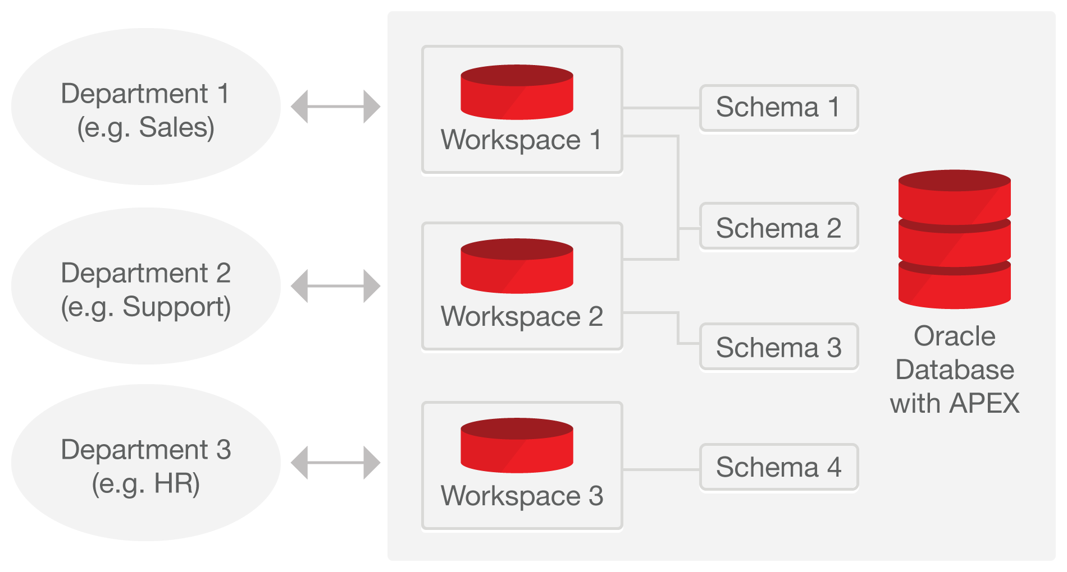
Oracle APEX - Concepts
Notes:
Workspace: A workspace is a logical work area which is associated with one or more Oracle database schemas. The schema(s) store the database objects that you build your applications on. A workspace enables multiple users to work within the same Oracle Application Express installation while keeping their objects, data and applications private. Each workspace has a unique ID and name.
Application: An application is an HTML interface that exists on top of database objects such as tables or procedures. Using Oracle Application Express, you create both database applications and Websheet applications. The main difference between these two types of applications is the intended audience. While database applications are primarily developed by application developers, Websheet applications are often created by end users with no development experience. In this course, you learn how to develop database applications.
User roles: Oracle Application Express users are divided in to four primary roles as:
End users do not have access to development or administrative capabilities. End users cannot sign into a workspace and create applications. End users can only run existing database or Websheet applications.
Developers are users who create and edit applications.
Workspace administrators are users who perform administrator tasks specific to a Workspace such as managing user accounts, monitoring workspace activity, and viewing log files.
Instance administrators are super users that manage an entire hosted instance using the Application Express Administration Services application. Instance administrators manage workspace provisioning, configure features and instance settings, and manage security.

Slide 19



Development / Deployment Options
Local
Install on stand-alone laptops using Oracle Express Edition (XE) or full database version
Simply upgrade APEX to the required version
Can work completely disconnected
On-Premise
Typically run by the IT Department
IT generally both production operations service, and a service provider
Departments responsible for application development
Cloud
Deploy Internet applications
Leveraged for fast application development, user acceptance and training.
Prototyping & Proof-of-Concept
Consulting companies develop for deployment on customer premise
Browser based application development framework enables efficient development & deployment
Shoot someone a URL – Check this out – Application Development
Notes:
Given APEX can run ‘anywhere you can install the Oracle Database’ you have great flexibility → Simply provide the appropriate URL to develop / run applications
Import an APEX application into any other Oracle Database where you have the same version or later of Application Express installed
Start developing on your laptop running Oracle XE or on the cloud and then simply export the application
Deploy on the Oracle Database Cloud Service and then once your application gets wide utilization move it to your private cloud.

Slide 20





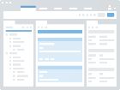







Oracle APEX: Low Code Data First App Development
Develop Database
Develop Application
Deploy
Database
App Builder
Test Application
Production Application
Existing
Existing
New
New
Markdown
Wizard
Metrics & Feedback
Database
Model
Blueprint
Install & Upgrade
Export
SQL IDE
DML Script
Excel
Source Code Control
Notes:
The benefits of low code development are greater productivity in less time at less cost and with greater consistency. Low code frameworks, such as Application Express, leverage powerful components that provide reporting, data visualization, and form controls. This enables an application developer to focus on solving the business problem and delivering superior solutions, with less time and effort spent on mundane and repetitive lower-level coding typically associated with application development.
Go from idea to production in days not weeks or months
Step 1 – Develop your Database Objects
Step 2 – Develop your apps directly on top of the DB Objects
Step 3 – Deploy the app
Oracle APEX is a low-code, high-productivity platform -- meaning you can start building your first app immediately! There are no pre-requisites, no software to install, and best-of-all, you can get started for free!
Oracle APEX combines the qualities of a low code tool, productivity, ease of use, and flexibility with the qualities of an enterprise development tool, security, integrity, scalability, availability and built for the web.

Slide 21
Oracle APEX
Getting Started

Slide 22
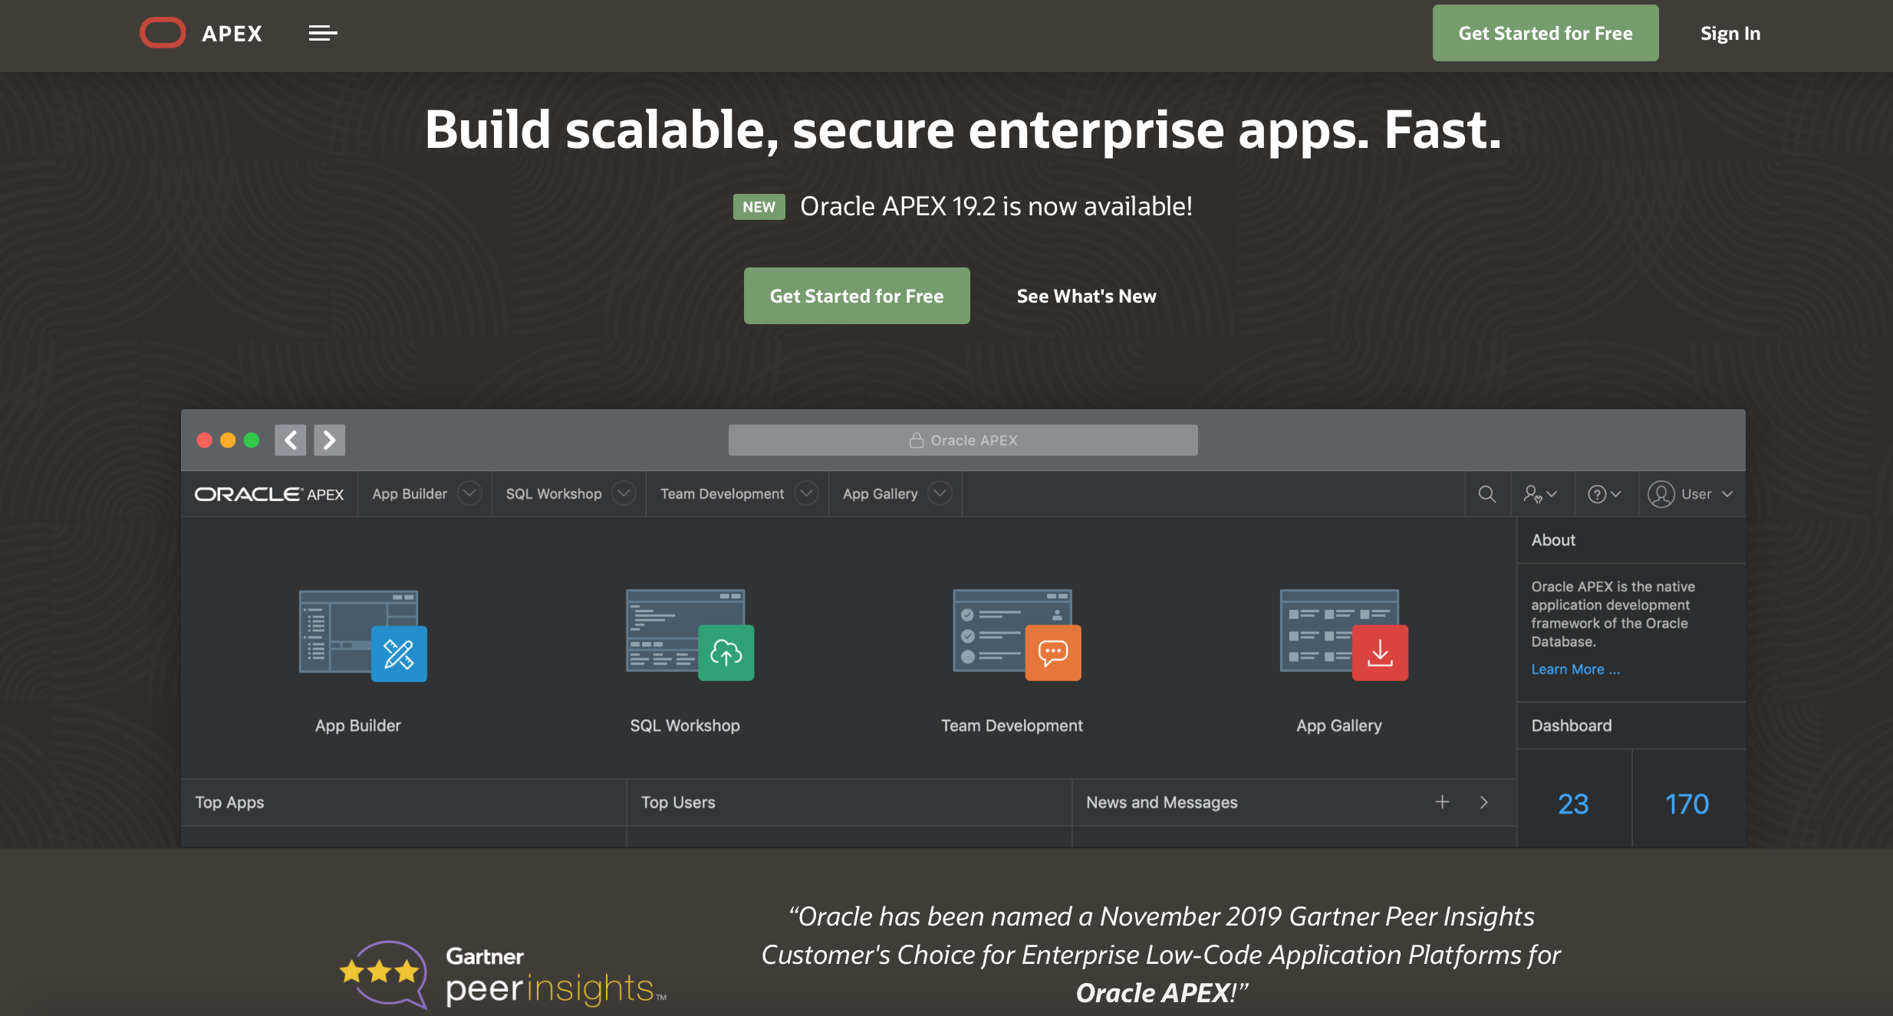
Getting Started…
Sign up for a free workspace on https:// apex.oracle.com
Notes:
To get stared with using Oracle Application Express, the first step is to obtain an Oracle Application Express workspace.
Select the most appropriate option from those listed below to obtain a Workspace:
apex.oracle.com - Request a workspace on Oracle’s free 'development only' service for evaluating the technology.
https://www.oracle.com/cloud/free/: Sign up for the new Always Free Cloud Tier to get two Oracle Autonomous Databases with powerful tools like Oracle APEX and SQL Developer.
Oracle Database 18c Express Edition - Download Oracle XE and install on your laptop or desktop machine and then download and install the latest Oracle Application Express release.
Oracle VM Virtual Box - Download Oracle VM Virtual Box and then import the Database Application Development Appliance which includes Oracle Database 19.3, and Oracle Application Express 19.1 pre-installed.
Note: The steps and screenshots in this student guide use the Workspace on apex.oracle.com.

Slide 23
Oracle APEX
Product Components

Slide 24
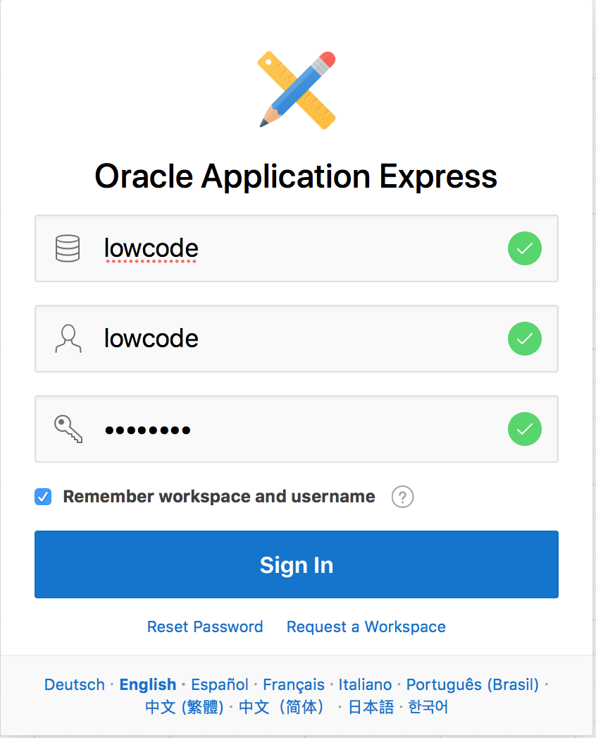
Logging In to a Workspace
Steps:
Enter the URL in your browser address bar.
Enter the workspace name.
Enter the username and password.
Click Sign In.
Notes:
To log in to Oracle Application Express, you need to specify the workspace name, the username and password created for that workspace. You can log in to Oracle Application Express either as a workspace administrator or as a developer.
Perform the following steps to log in to your Application Express Workspace:
You access the Oracle Application Express environment with the URL: http://<hostname>:<port>/apex
The login page appears. Enter the workspace name, username, and password.
Click Sign In. You may be prompted to change your workspace password the first time you log in.

Slide 25
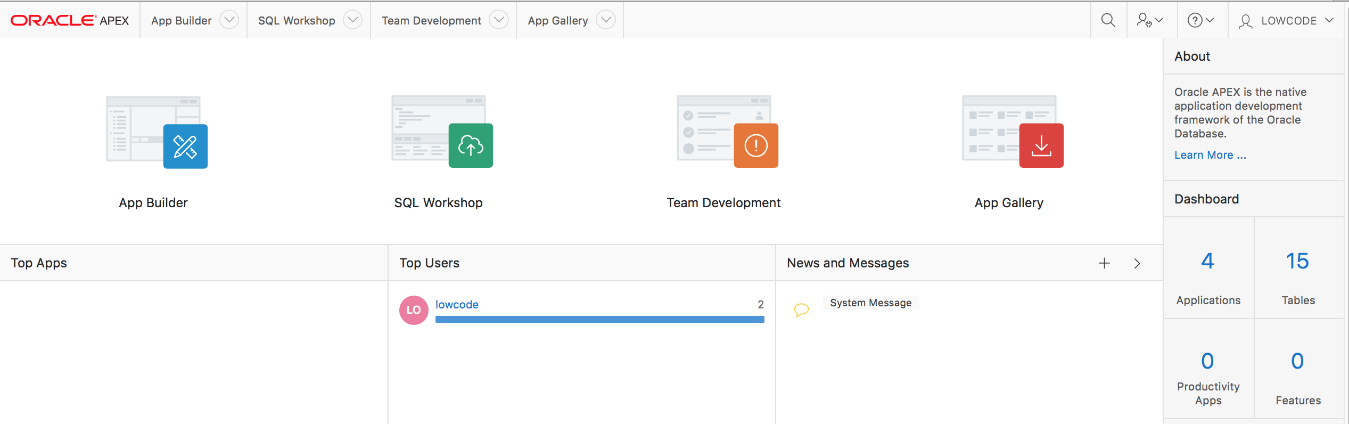
Oracle APEX - Major Components
Comprehensive Development IDE, Web Application Development, and SQL Database Development
Notes:
When you sign in to Oracle Application Express development environment, the Workspace home page appears. The Oracle Application Express development environment consists of four components:
App Builder
SQL Workshop
Team Development
Packaged Apps

Slide 26
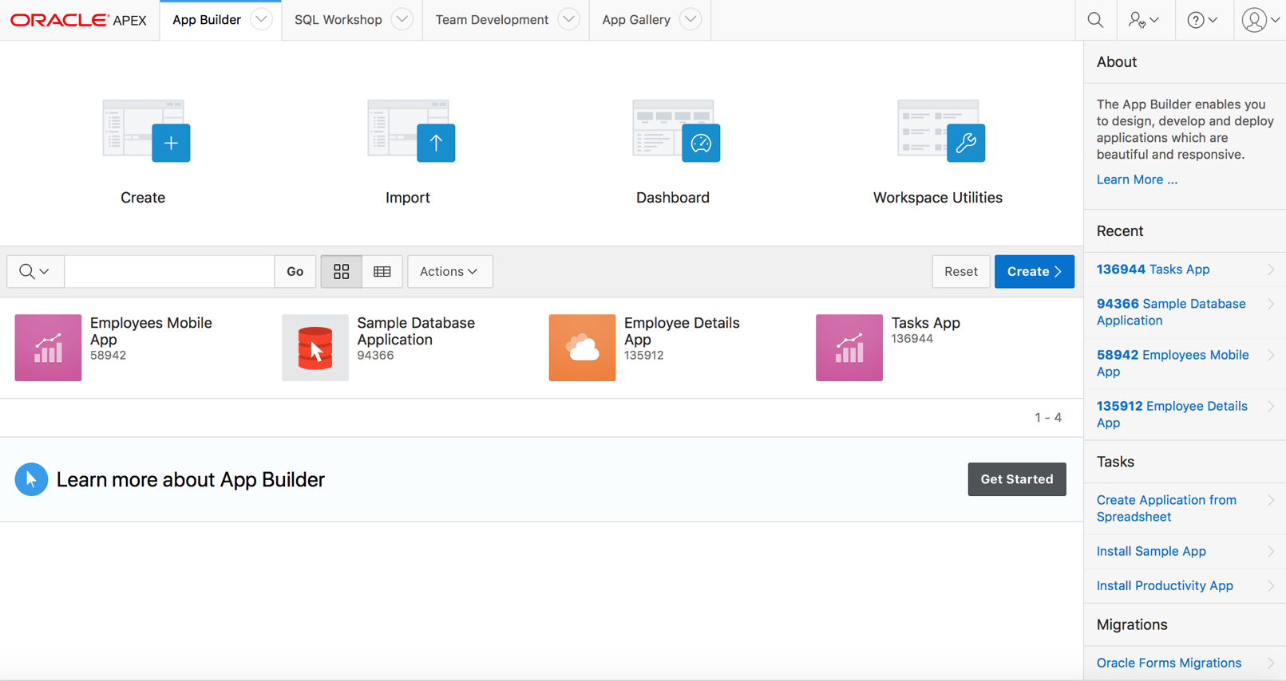
Oracle APEX - App Builder
Notes:
Developers use App Builder to create the pages that make up an Oracle Application Express application. You spend the majority of your time in the App Builder defining, enhancing and maintaining applications.

Slide 27
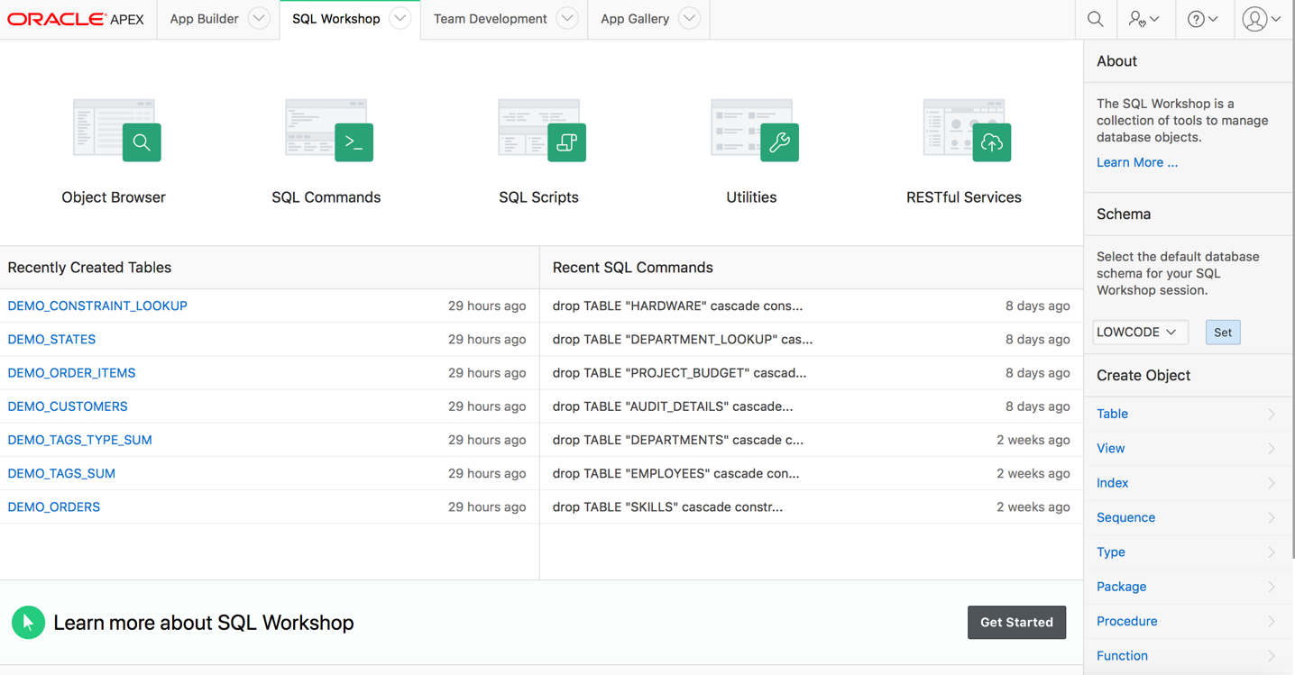
Oracle APEX - SQL Workshop
Browser based maintenance of database objects and data
Designed to meet application developers’ needs, especially in hosted environments
Notes:
The SQL Workshop provides tools to view and manage database objects and data. SQL Workshop is sometimes the only means developers can maintain DB objects as they may not have direct access to the schema(s) via SQL*Net, especially if they are using a hosted service. The functionality available through SQL Workshop is a subset of SQL Developer and is designed specifically for developers to be able to maintain their DB objects.

Slide 28
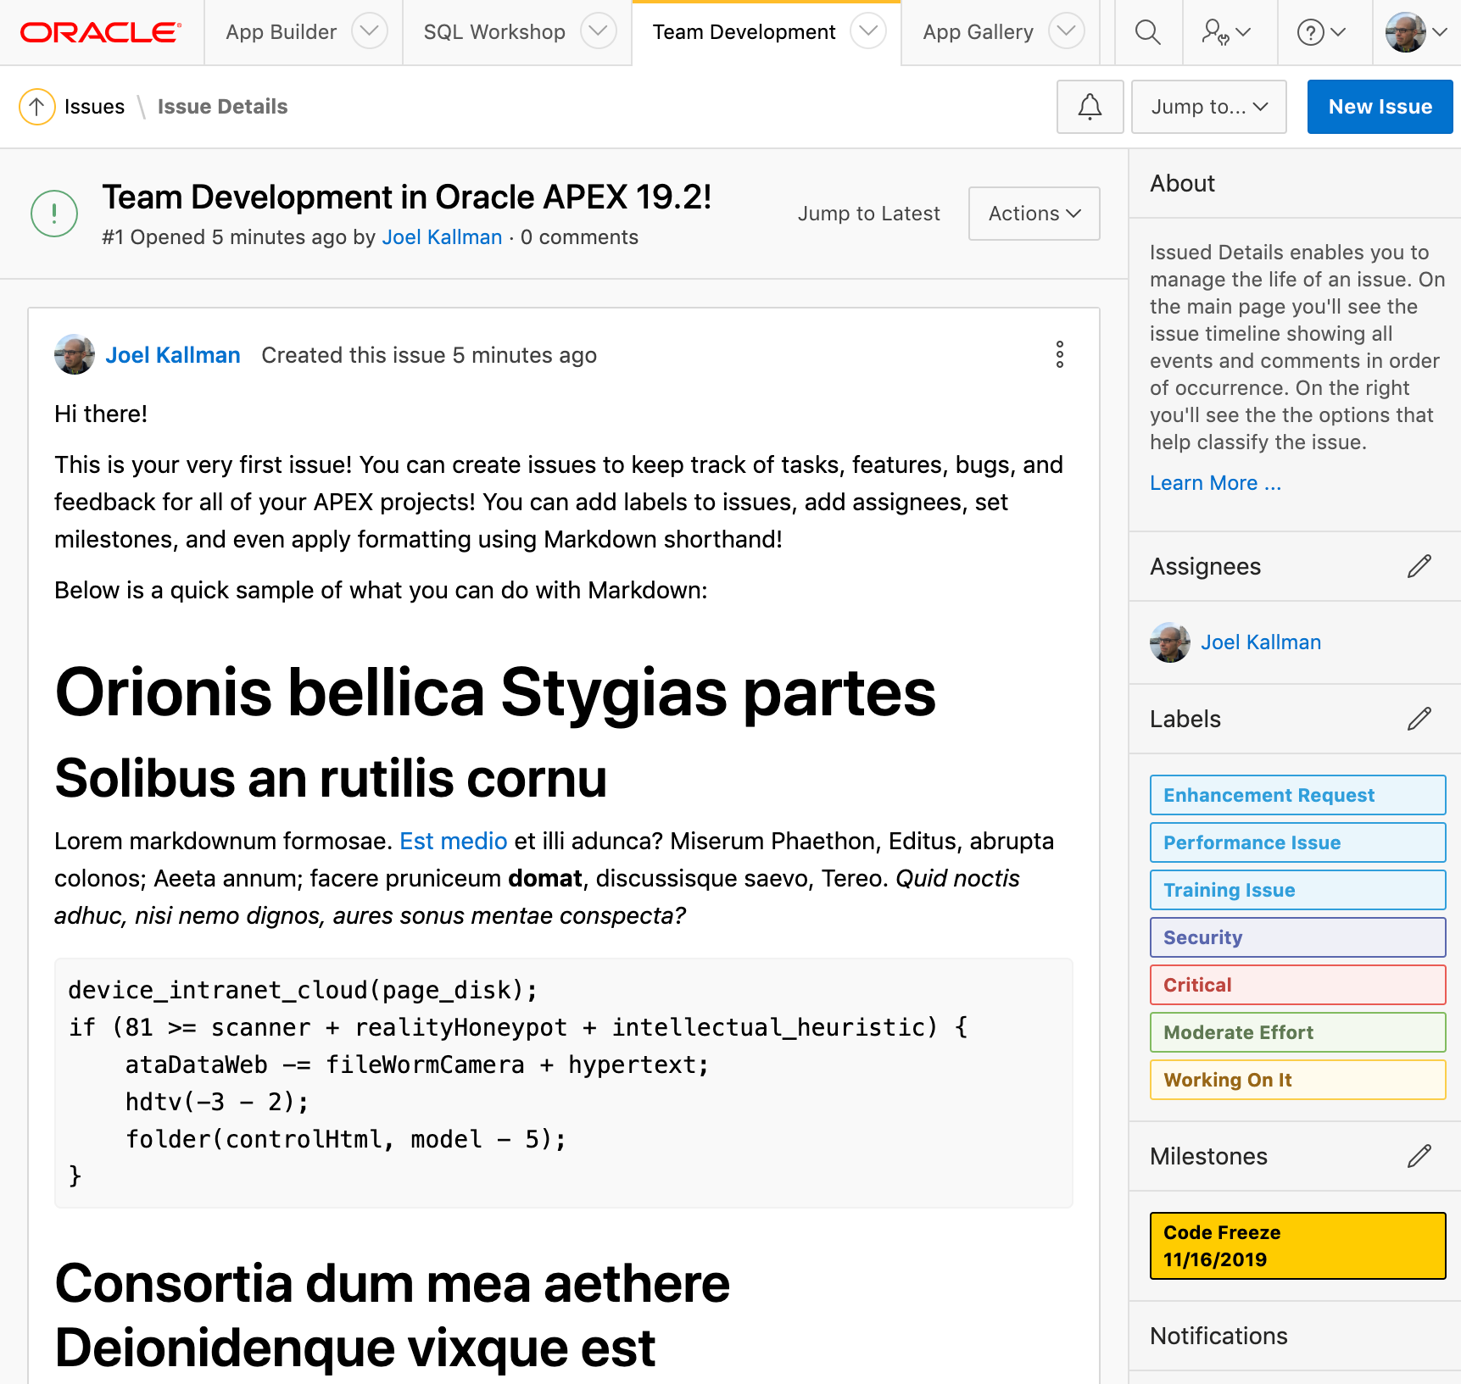
Oracle APEX - Team Development
Use Team Development to track and manage issues in a conversational fashion.
Create templates to provide users with starter text for issues and comments.
Apply labels and label groups, assign issue owners, and set milestones.
Notes:
Team Development provides the ability to manage the full lifecycle of your application development.
Features, To-Dos, and Bugs can be assigned to specific applications and pages.
Feedback allows developers to easily gather comments, enhancements, and bugs directly from their user community and includes important session state information to assist the developers with diagnosis.

Slide 29
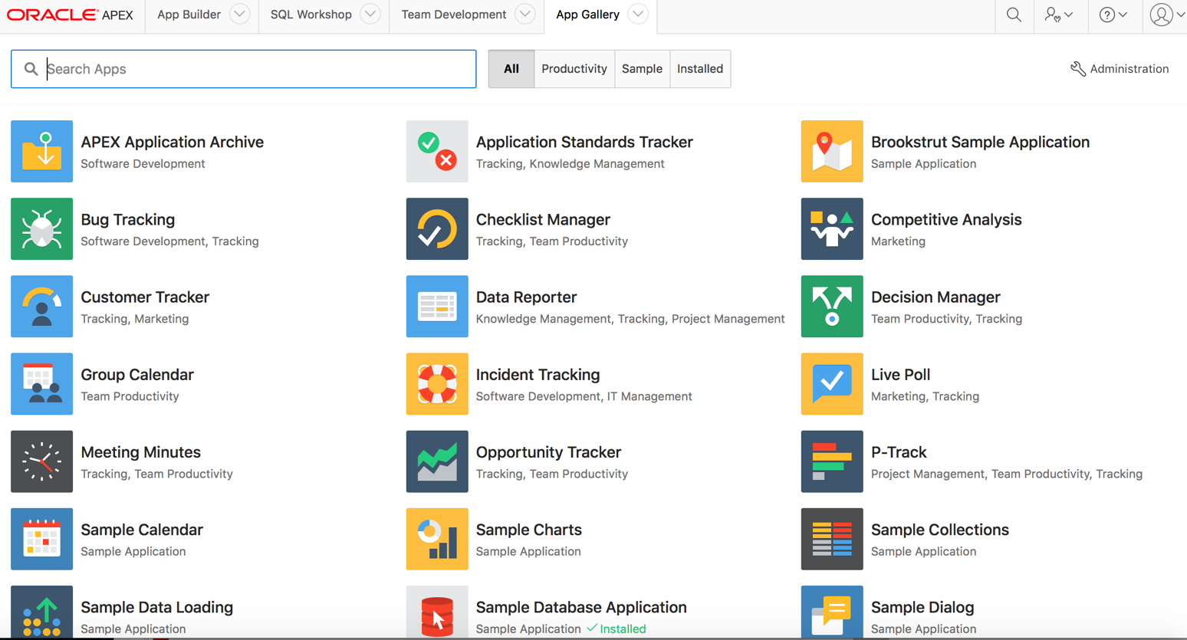
Oracle APEX – App Gallery
Notes:
Packaged apps are a suite of business productivity applications, easily installed with only a few clicks. These solutions can be readily used as production applications to improve business processes and are fully supported by Oracle. Packaged Applications also include a collection of sample applications which demonstrate some of the major features of Oracle Application Express.

Slide 30
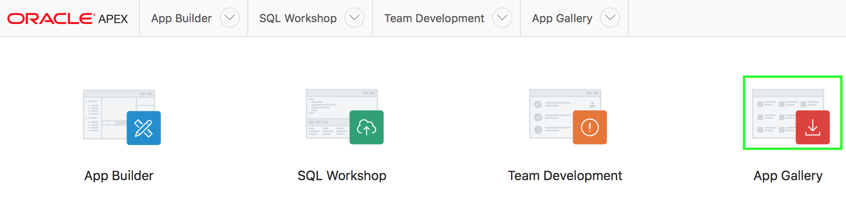
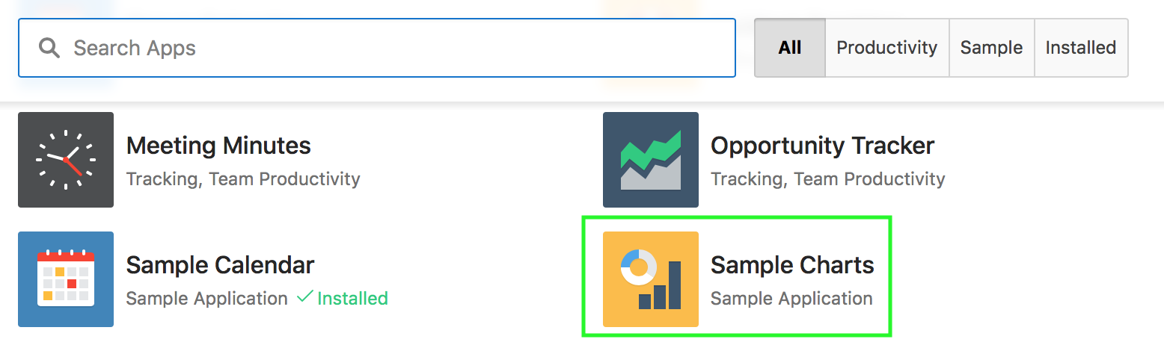
Installing a Packaged App
1
2
Notes:
The slide shows steps to install a packaged app in your Oracle Application Express Workspace.
Log in to your Oracle Application Express Workspace. On the Workspace home page, click App Gallery.
From the list of applications, select the packaged application that you want to install. For example, in the slide, you select Sample Charts application.

Slide 31
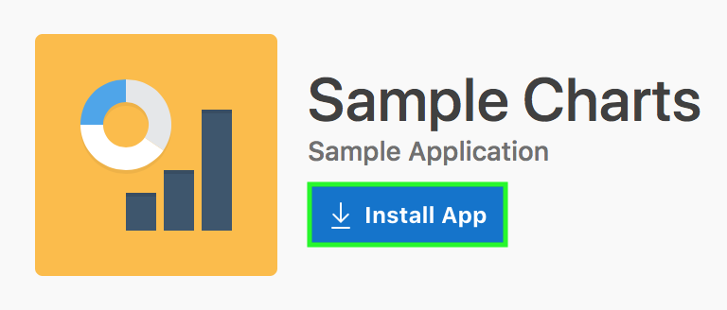
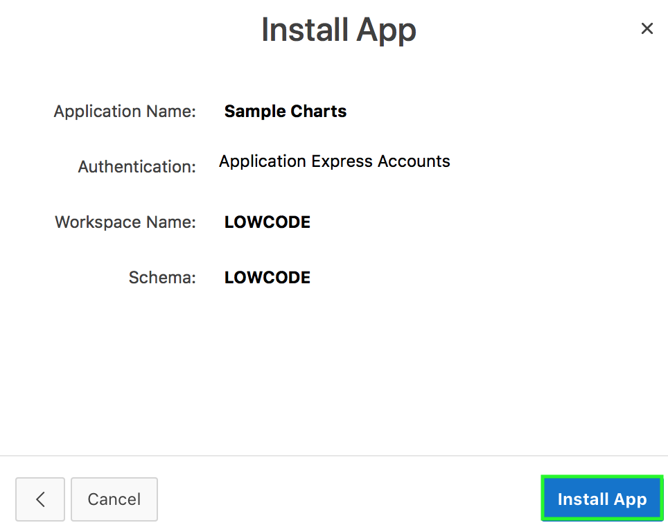
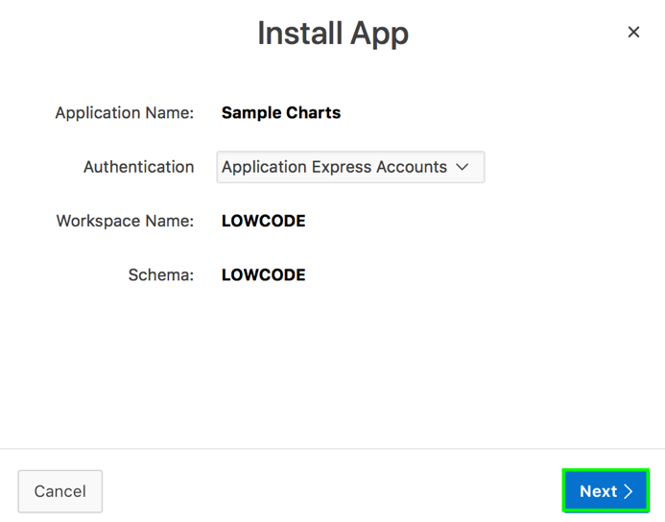
Installing a Packaged App
3
4
5
Notes:
Click Install App to initiate the process of installing the application
Accept the defaults for authentication and click Next.
Now, click Install Packaged App. The application gets installed in your workspace.

Slide 32
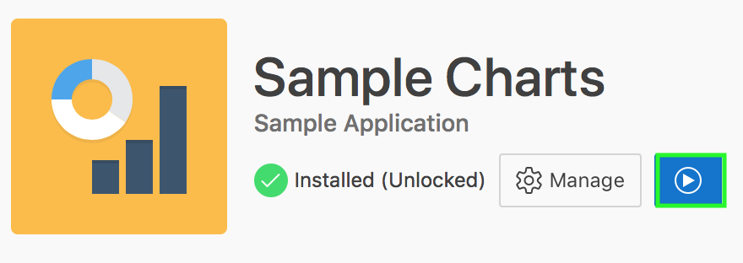
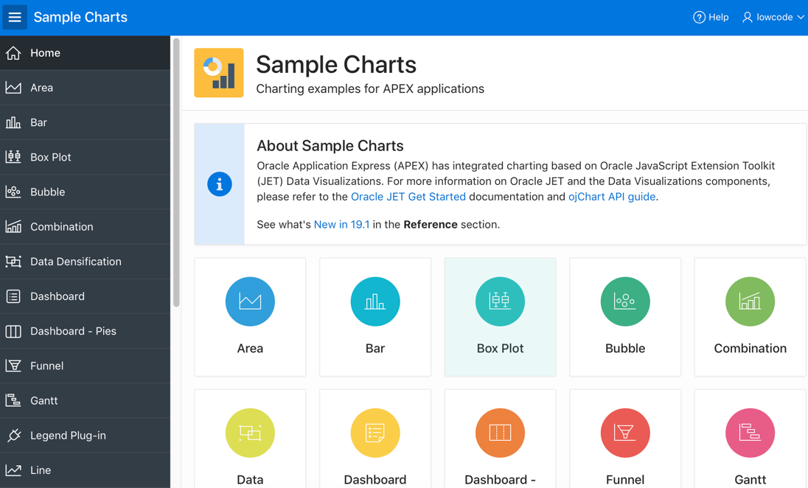
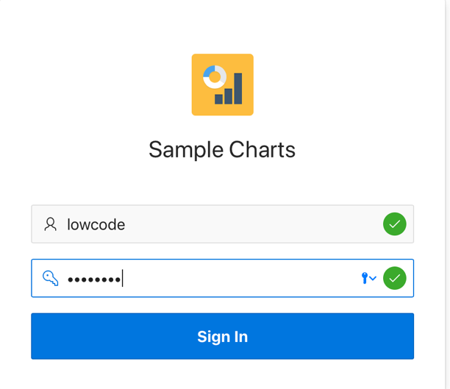
Running the Packaged App
1
2
Notes:
After installing the packaged app as in the previous slide, you run the application.
Click Run Application.
Enter your Username and Password. Click Sign In. The application home page appears.

Slide 33
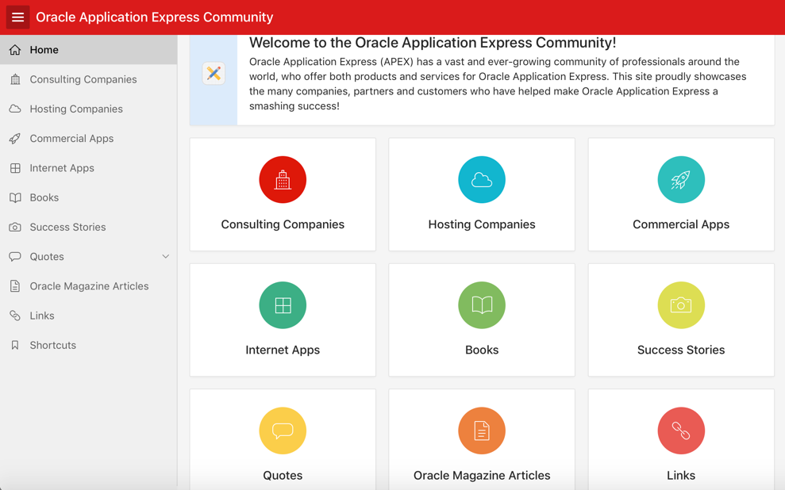
Oracle APEX - Community
Community
Over 500,00 developers worldwide
Estimated from support requests, downloads, conferences, discussion forum activity
More than 100 active bloggers http://odtug.com/apex
http://apex.oracle.com/community Consulting companies, books, success stories, quotes, commercial apps
Notes:
Feeling stuck? want to learn more? share your success? or meet with other like-minded developers? There's everything from books, discussion forums and community-driven websites to local meet-ups and worldwide conferences to cater to your every APEX-related need! Check out our community site, apex.oracle.com/community, for much much more!

Slide 34
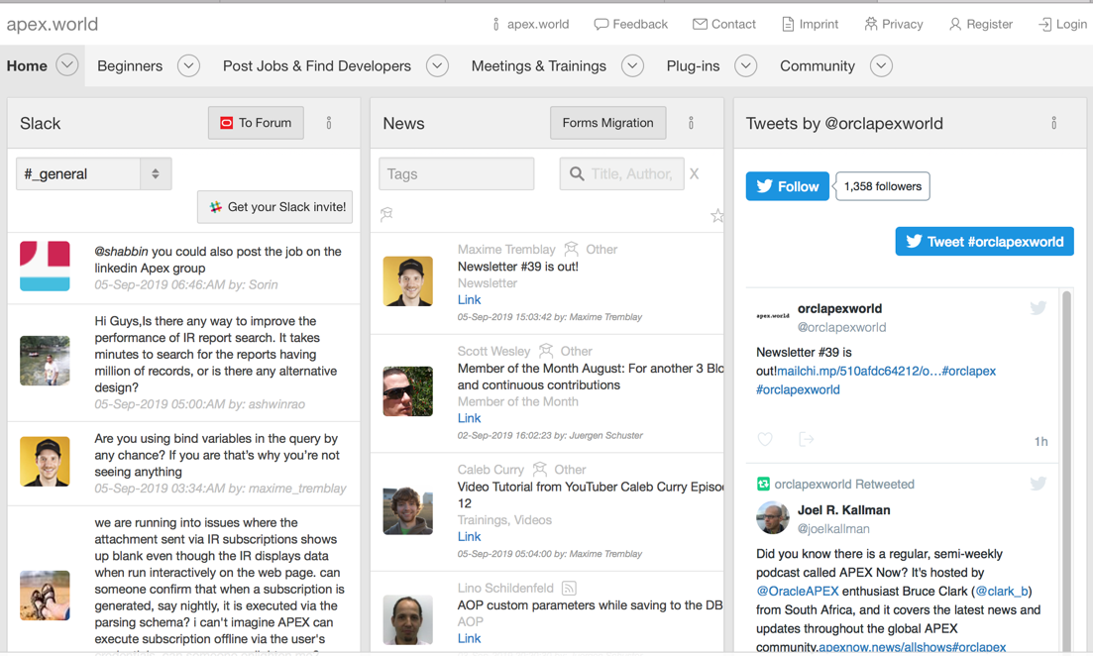
http://apex.world
Oracle APEX - Community
Community site built by the community for the community
Community-authored site providing:
Plug-ins
Slack discussion channels
Twitter feeds
News
Jobs
Conferences
Meetups

Slide 35
Oracle APEX
Examples of How Oracle Uses Oracle APEX

Slide 36
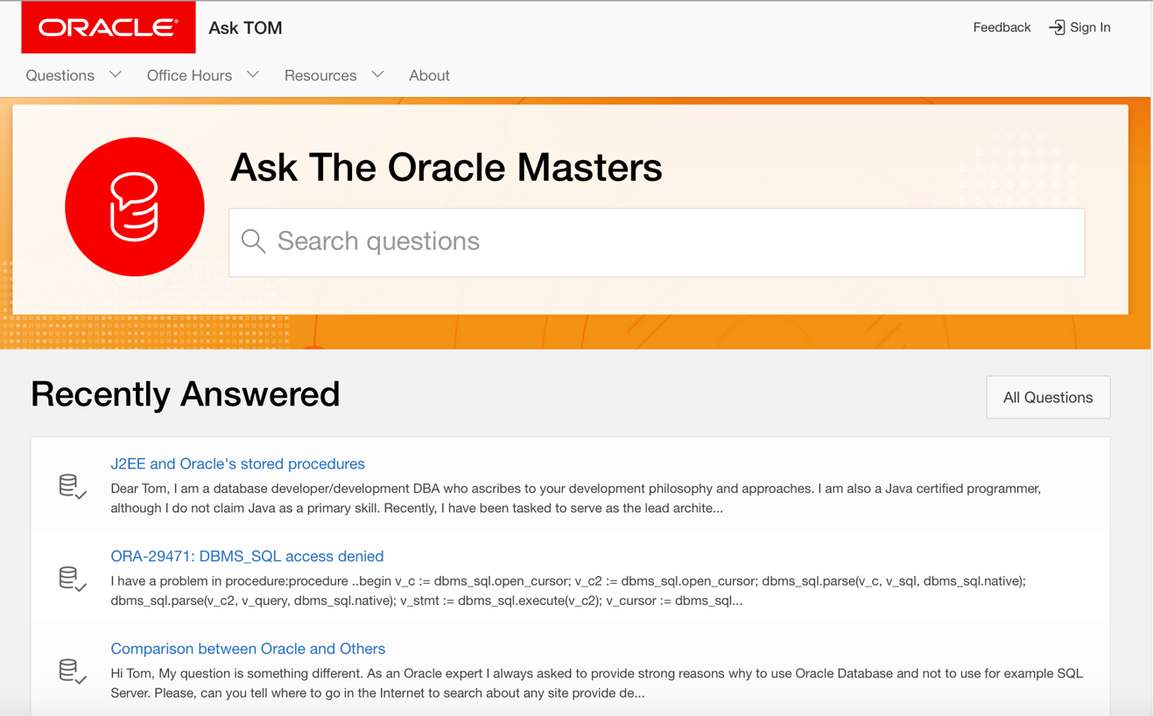
Oracle Ask Tom [Internet Application]
https://asktom.oracle.com
Notes:
Ask TOM is an on-line repository of over 18,400 questions and answers that have been answered by the Ask TOM team. This content covers many topics related to building applications on top of Oracle Database. Ask TOM one of the leading sites online to learn about Oracle Database, so if you have a question about Oracle Database that you can't solve yourself, be sure to ask it here!

Slide 37
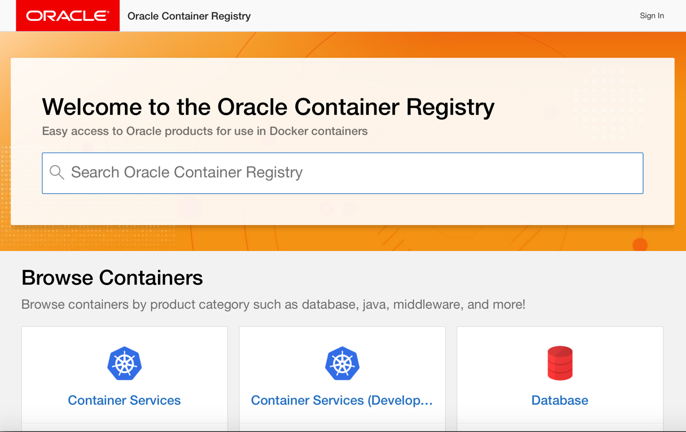
Oracle Container Registry [Internet Application]
https://container-registry.oracle.com

Slide 38
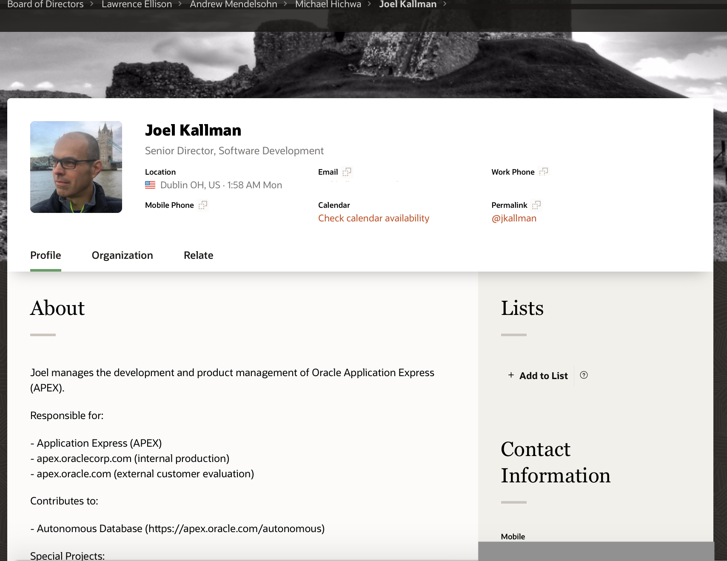
HR Directory [Internal Only – Intranet Application]
ARIA People
Nightly download of HR data
Employees can update profile, upload picture, add links ...
Used to contact employees, see Org. Chart, etc.
Fully responsive, works just as well on smartphones as it does on tablets and notebooks.
Average ~ 1.5 million page views / day ( > 50 page views / sec for hours )
Median execution time of 0.04 seconds
Notes:
Aria People is Oracle's employee directory app where you can easily look up employees, find contact information, create lists, and more.

Slide 39
Useful Links
Collateral, Resources and Hosted Services
Free APEX Service https://apex.oracle.com
Oracle Technology Network https://apex.oracle.com/otn
APEX Community https://apex.oracle.com/community
APEX & Low Code https://apex.oracle.com/lowcode
Quick SQL https://apex.oracle.com/quicksql
Database Cloud Services https://cloud.oracle.com/database
Oracle Learning Library https://www.oracle.com/oll
Oracle APEX Education https://apex.oracle.com/education
Oracle Cloud Free Tier https://www.oracle.com/cloud/free/
Notes:
These are the primary URLs you need to get more information on Oracle Application Express!

Slide 40
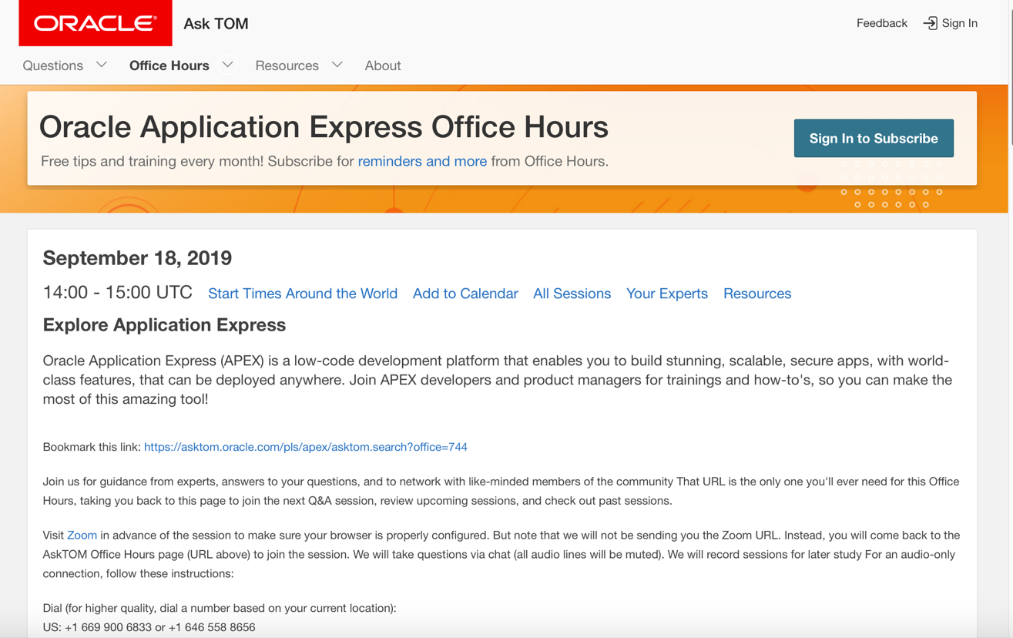
Oracle Application Express Office Hours
https://apex.oracle.com/en/officehours/
Notes:
Join Oracle APEX Office Hours for guidance from experts, answers to your questions, and to network with like-minded members of the community. That URL in the slide is the only one you will ever need for this Office Hours, taking you back to this page to join the next Q&A session, review upcoming sessions, and check out past sessions.

Slide 41
Summary
In this lesson, you learned how to:
Log in to Oracle Application Express development environment
Navigate through the major components of Oracle Application Express
Install and run a packaged application

Slide 42


Slide 43
Hands-on Lab

